Slide 1

Fundamental Of Structured Programming Lecture 3
By
Dr. Naglaa Fathy
Lecturer, Computer Science Department,
Faculty of computers and artificial intelligence, benha university

Slide 2


Slide 3
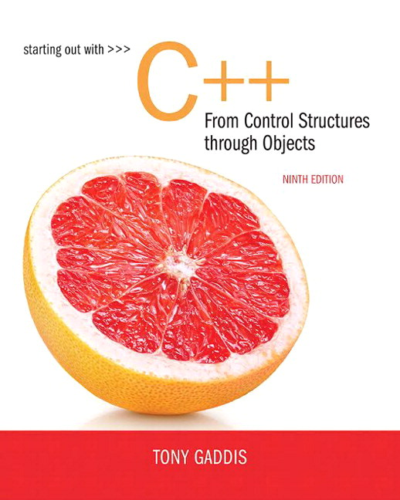
Lectures References
Starting out with C++ From Control Structures through Objects
TONY GADDIS
Ninth Edition.

Slide 4
Course Materials
All course material will be made available on Fundamental of Structured Programming Google Drive Folder
https://drive.google.com/drive/folders/1tPM-3Xj4whtwlWia_tA0GaZVx_FTvJoC?usp=sharing

Slide 5
Assignments
Write an algorithm to read 100 numbers then display the largest.
start
N=1
Get value
Max=value
N=N+1
N
If N<=100
Y
If max<value
Y
Print max
N
Get value
Max=value
End

Slide 6

Chapter 2: Introduction to C++

Slide 7
The Parts of a C++ Program
// sample C++ program
#include <iostream>
using namespace std;
int main()
{
cout << "Hello, there!";
return 0;
}
comment
preprocessor directive
which namespace to use
beginning of function named main
beginning of block for main
output statement
string literal
Send 0 to operating system
end of block for main
Notes:
#include <iostream> Preprocessor directive — Tells the compiler to include the input/output stream library, which allows the use of cout and cin.
Namespace declaration — Lets you use names (like cout, cin, etc.) from the std (standard) namespace without typing std:: before them.

Slide 8
Special Characters
Character | Name | Meaning
// | Double slash | Beginning of a comment
# | Pound sign | Beginning of preprocessor directive
< > | Open/close brackets | Enclose filename in #include
( ) | Open/close parentheses | Used when naming a function
{ } | Open/close brace | Encloses a group of statements
" " | Open/close quotation marks | Encloses string of characters
; | Semicolon | End of a programming statement

Slide 9
The cout Object
Displays output on the computer screen
You use the stream insertion operator << to send output to cout:
cout << "Programming is fun!";
Can be used to send more than one item to cout:
cout << "Hello " << "there!";
Or: cout << "Hello ";
cout << "there!";
This produces one line of output: cout << "Programming is "; cout << "fun!";

Slide 10
The endl Manipulator
You can use the endl manipulator to start a new line of output. This will produce two lines of output:
cout << "Programming is" << endl; cout << "fun!";
You do NOT put quotation marks around endl
The last character in endl is a lowercase
L, not the number 1
Programming is
fun!
endl
This is a lowercase L

Slide 11
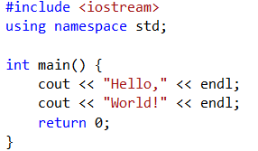
Example about endl
Program Output:
Hello,
World!

Slide 12
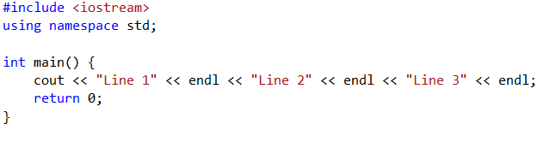
Example about endl
Program Output:
Line 1
Line 2
Line 3

Slide 13
The \n Escape Sequence
You can also use the \n escape sequence to start a new line of output. This will produce two lines of output:
cout << "Programming is\n"; cout << "fun!";
Notice that the \n is INSIDE
the string.
Programming is
fun!

Slide 14
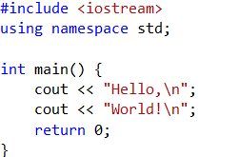
Example
Program Output:
Hello,
World!

Slide 15
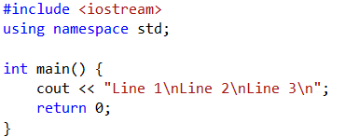
Example
Program Output:
Line 1
Line 2
Line 3

Slide 16
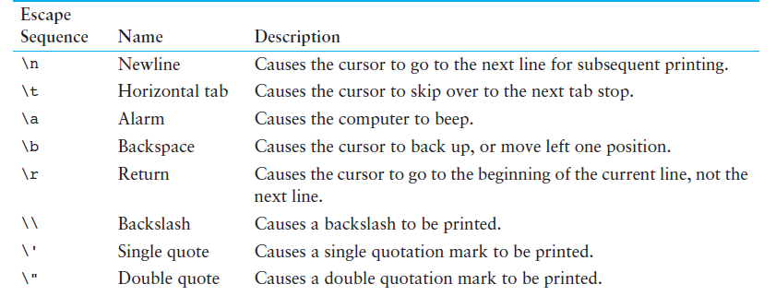
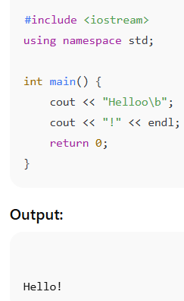
Escape Sequences – More Control Over Output

Slide 17
The #include Directive
Inserts the contents of another file into the program
This is a preprocessor directive,
not part of C++ language
#include lines not seen by the compiler
Do not place a semicolon at the end of #include the line

Slide 18
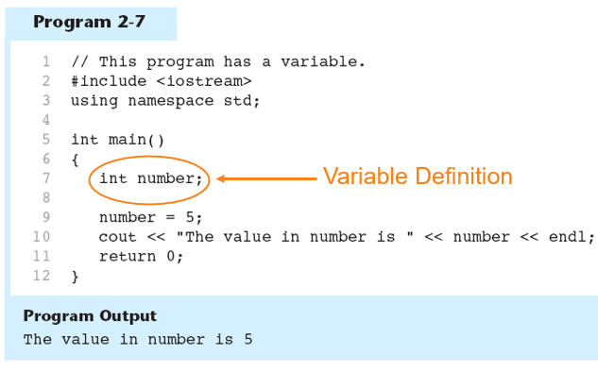
Variables and Literals
Variable: a storage location in memory
Has a name and a type of data it can hold
Must be defined before it can be used:
int item;

Slide 19
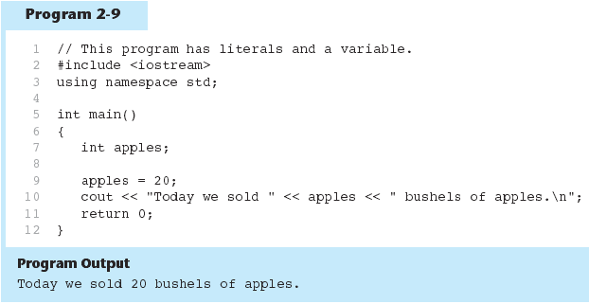
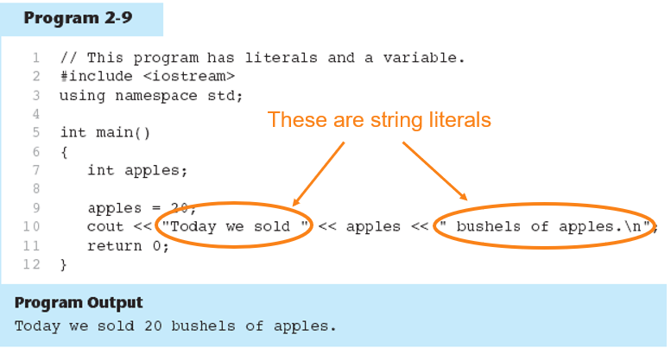
Literals
Literal: a value that is written into a program’s code.
"hello, there" (string literal)
12 (integer literal)
Data item whose value does not change
during program execution.
Is also called a constant
'A' // character constant
"Hello" // string literal
12 // integer constant
3.14 //floating-point constant
20 is an integer literal

Slide 20
Identifiers
An identifier is a programmer-defined name for some part of a program: variables, functions, etc.
A variable name should represent the purpose of the variable. For example: itemsOrdered The purpose of this variable is to hold the number of items ordered.
Identifiers rules:
The first character of an identifier must be an alphabetic character or and underscore ( _ ),
After the first character you may use alphabetic characters, numbers, or underscore characters.
Upper- and lowercase characters are distinct

Slide 21
Multi-word Variable Names
Descriptive variable names may include multiple words
Two conventions to use in naming variables:
Capitalize all but first letter of first word. Run words together:
quantityOnOrder
totalSales
Use the underscore _ character as a space:
quantity_on_order
total_sales
Use one convention consistently throughout program

Slide 22
Valid and Invalid Identifiers
IDENTIFIER | VALID? | REASON IF INVALID
totalSales | Yes
total_Sales | Yes
total.Sales | No | Cannot contain .
4thQtrSales | No | Cannot begin with digit
totalSale$ | No | Cannot contain $

Slide 23
Assignment Statement
Uses the = operator.
Has a single variable on the left side and a value on the right side.
Copies the value on the right into the variable on the left.
Example
item = 12;

Slide 24
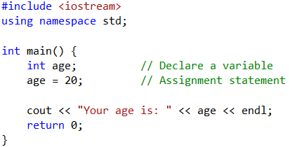
Example
Program Output:
Your age is: 20

Slide 25
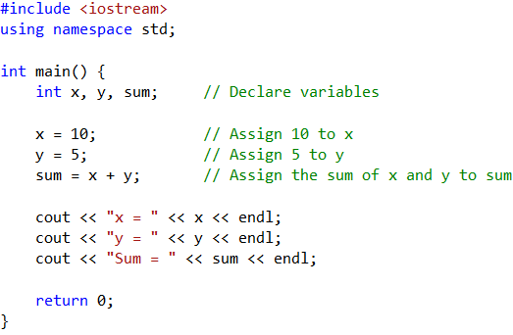
Example
Program Output:
x = 10
y = 5
Sum = 15

Slide 26
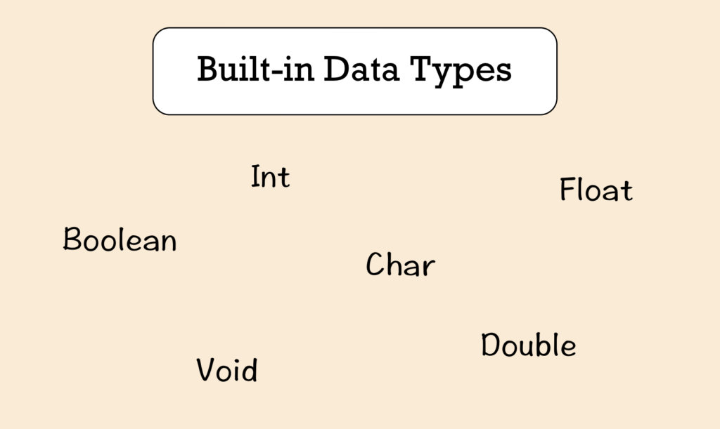
Data types

Slide 27
Data Types
Data Types
Structured
Integral
Floating-Point
Pointers
Simple
Enumeration

Slide 28
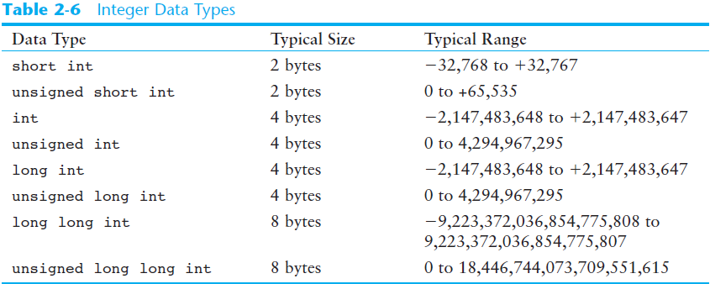
Integer Data Types
Integer variables can hold whole numbers such as 12, 7, and -99.
Designed to hold whole (non-decimal) numbers.
Can be signed or unsigned
12 -6 +3
Available in different sizes (i.e., number of bytes): short, int, and long.
Size of short ≤ size of int ≤ size of long.

Slide 29
Signed vs. Unsigned Integers
C++ allocates one bit for the sign of the number, and the rest of the bits are for data.
If your program will never need negative numbers, you can declare variables to be unsigned. All bits in unsigned numbers are used for data.
A variable is signed unless the unsigned keyword is used.

Slide 30
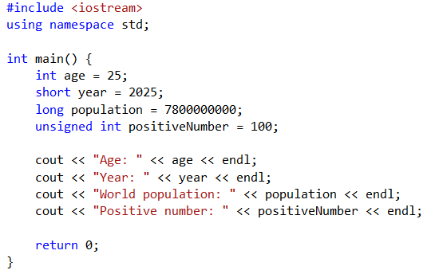
Example
Program Output:
Age: 25
Year: 2025
World population: 7800000000
Positive number: 100

Slide 31
Floating-point data types
Floating-point types represent numbers with decimal points.
The two main types are float and double.
float: uses 4 bytes, suitable for basic fractional calculations.
double: uses 8 bytes,, ideal for scientific and engineering work.
Both can handle positive and negative values and represent very large or small numbers using scientific notation.

Slide 32
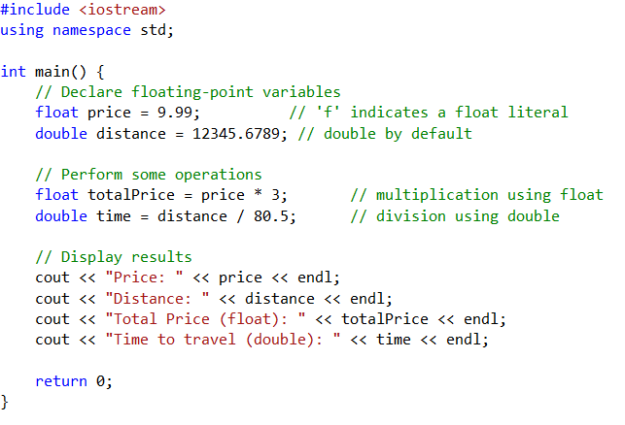
Example
Program Output:
Price: 9.99
Distance: 12345.7
Total Price (float): 29.97
Time to travel (double): 153.323

Slide 33
The char Data Type
Used to hold single characters or very small integer values.
Usually occupies 1 byte of memory.
A numeric code representing the character is stored in memory .
Example
SOURCE CODE MEMORY
char letter = ‘C'; letter
67
Notes:
See pr2-12.cpp and pr2-13.cpp

Slide 34
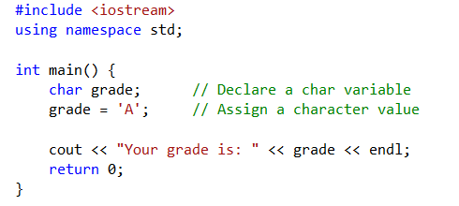
Example
Program Output:
Your grade is: A

Slide 35
Character Literal
A character literal is a single character
When referenced in a program, it is enclosed in single quotation marks:
cout << 'Y' << endl;
The quotation marks are not part of the literal, and are not displayed

Slide 36
String Literals
Can be stored as a series of characters in consecutive memory locations.
"Hello"
Stored with the null terminator, \0, automatically placed at the end.
Is comprised of characters between the “ and "
H | e | l | l | o | \0

Slide 37
A character or a string literal?
A character literal is a single character, enclosed in single quotes:
'C'
A string literal is a sequence of characters enclosed in double quotes:
"Hello, there!"
A single character in double quotes is a string literal, not a character literal:
"C"
Notes:
See pr2-14.cpp

Slide 38
The C++ string Class
Must #include <string> to create and use string objects
Can define string variables in programs
string name;
Can assign values to string variables with the assignment operator
name = "George";
Can display them with cout
cout << "My name is " << name;

Slide 39
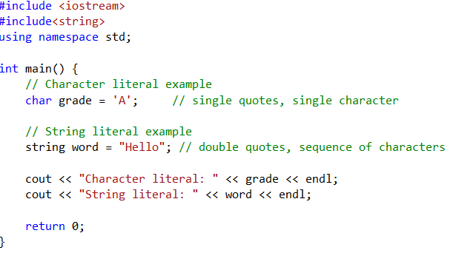
Example
Output program:
Character literal: A
String literal: Hello

Slide 40
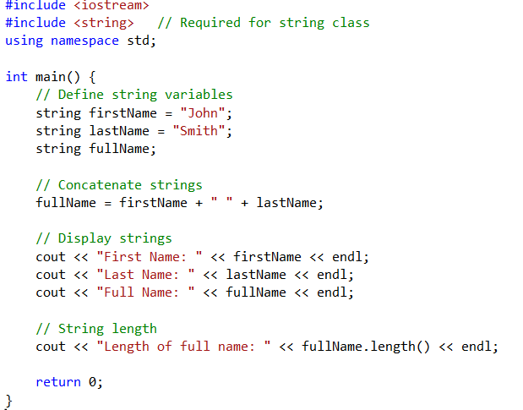
Example
Program Output:
First Name: John
Last Name: Smith
Full Name: John Smith
Length of full name: 10

Slide 41
The bool Data Type
Represents values that are true or false
bool values are stored as integers
false is represented by 0, true by 1
bool allDone = true;
bool finished = false;
Notes:
See pr2-16.cpp

Slide 42
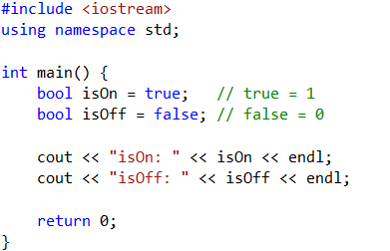
Example
Program Output:
isOn: 1
isOff: 0

Slide 43
Determining the Size of a Data Type
The sizeof operator gives the size in number of bytes of any data type or variable
double amount;
cout << "A float is stored in "
<< sizeof(float) << " bytes\n";
cout << "Variable amount is stored in "
<< sizeof(amount) << " bytes\n";
Notes:
See pr2-17.cpp

Slide 44
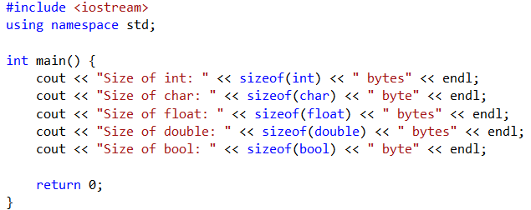
Example
Program Output:
Size of int: 4 bytes
Size of char: 1 byte
Size of float: 4 bytes
Size of double: 8 bytes
Size of bool: 1 byte

Slide 45
More on Variable Assignments and Initialization
Assigning a value to a variable
Assigns a value to a previously created variable
A single variable name must appear on left side of the = symbol
int size;
size = 5; // legal
5 = size; // not legal

Slide 46
Variable Assignment vs. Initialization
Initializing a variable
Gives an initial value to a variable at the time it is created
Can initialize some or all of the variables being defined
int length = 12;
int width = 7, height = 5, area;
Notes:
See pr2-18.cpp

Slide 47
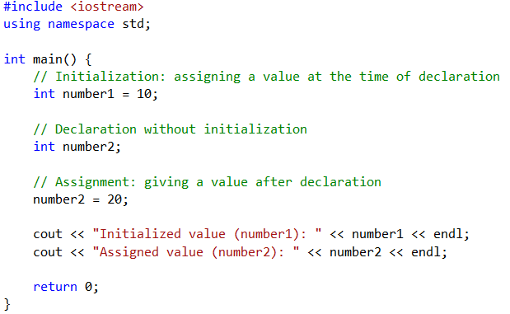
Example
Program Output:
Initialized value (number1): 10
Assigned value (number2): 20

Slide 48
Arithmetic Operators
Used for performing numeric calculations
C++ has unary, binary, and ternary operators
unary (1 operand) -5
binary (2 operands) 13 - 7
ternary (3 operands) exp1? exp2 :exp3

Slide 49
Binary Arithmetic Operators
SYMBOL | OPERATION | EXAMPLE | ans
+ | addition | ans = 7 + 3; | 10
- | subtraction | ans = 7 - 3; | 4
* | multiplication | ans = 7 * 3; | 21
/ | division | ans = 7 / 3; | 2
% | modulus | ans = 7 % 3; | 1
Notes:
See pr2-20.cpp

Slide 50
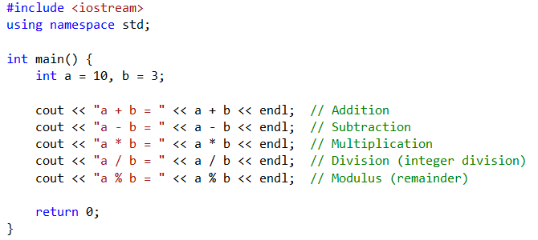
Example
Program Output:
a + b = 13
a - b = 7
a * b = 30
a / b = 3
a % b = 1

Slide 51
/ Operator
C++ division operator (/)performs integer division if both operands are integers
cout << 13 / 5; // displays 2
cout << 2 / 4; // displays 0
If either operand is floating-point, the result is floating-point
cout << 13 / 5.0; //displays 2.6
cout << 2.0 / 4; // displays 0.5

Slide 52
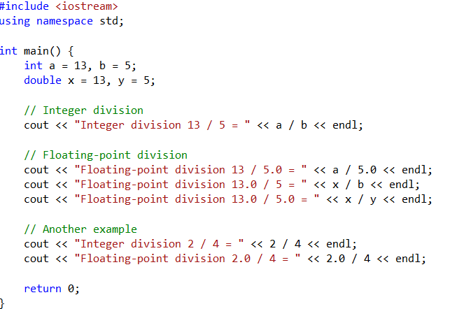
Example
Program Output:
Integer division 13 / 5 = 2
Floating-point division 13 / 5.0 = 2.6
Floating-point division 13.0 / 5 = 2.6
Floating-point division 13.0 / 5.0 = 2.6
Integer division 2 / 4 = 0
Floating-point division 2.0 / 4 = 0.5

Slide 53
% Operator
C++ modulus operator (%) computes the remainder resulting from integer division
cout << 9 % 2; // displays 1
% requires integers for both operands
cout << 9 % 2.0; // error
Notes:
See pr2-21.cpp

Slide 54
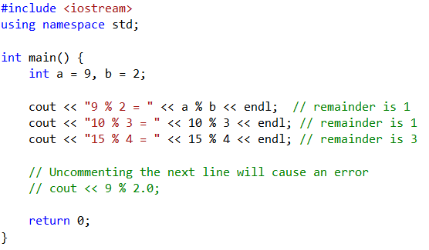
Example
Program Output:
9 % 2 = 1
10 % 3 = 1
15 % 4 = 3

Slide 55
Comments
Are used to document parts of a program.
Are written for persons reading the source code of the program.
Indicate the purpose of the program.
Describe the use of variables.
Explain complex sections of code.
Are ignored by the compiler.

Slide 56
Single-Line Comments
Begin with // and continue to the end of line
int length = 12; // length in inches
int width = 15; // width in inches
int area; // calculated area
// Calculate rectangle area
area = length * width;
Notes:
See pr2-22.cpp

Slide 57
Multi-Line Comments
Begin with /* and end with */
Can span multiple lines
/*----------------------------
Here's a multi-line comment
----------------------------*/
Can also be used as single-line comments
int area; /* Calculated area */

Slide 58
Thank you

